Slide 1
CSS for Styling

Slide 2
CSS properties for fonts
property | description
font-family | which font will be used
font-size | how large the letters will be drawn
font-style | used to enable/disable italic style
font-weight | used to enable/disable bold style
Complete list of font properties (http://www.w3schools.com/css/css_reference.asp#font)

Slide 3
font-family
p {
font-family: Georgia;
}
h2 {
font-family: "Courier New";
} CSS
This paragraph uses the first style above.
This h2 uses the second style above.
output
Enclose multi-word font names in quotes

Slide 4
More about font-family
p {
font-family: Garamond, "Times New Roman", serif;
} CSS
This paragraph uses the above style. output
We can specify multiple fonts from highest to lowest priority
Generic font names:
serif, sans-serif, cursive, fantasy, monospace
If the first font is not found on the user's computer, the next is tried
Placing a generic font name at the end of your font-family value, ensures that every computer will use a valid font

Slide 5
font-size
p {
font-size: 24pt;
} CSS
This paragraph uses the style above. output
units: pixels (px) vs. point (pt) vs. m-size (em)
16px, 16pt, 1.16em
vague font sizes: xx-small, x-small, small, medium, large, x-large, xx-large, smaller, larger
percentage font sizes, e.g.: 90%, 120%

Slide 6
font-size
p {
font-size: 24pt;
} CSS
This paragraph uses the style above. output
pt specifies number of point, where a point is 1/72 of an inch onscreen
px specifies a number of pixels on the screen
em specifies number of m-widths, where 1 em is equal to the font's current size

Slide 7
font-weight, font-style
p {
font-weight: bold;
font-style: italic;
} CSS
This paragraph uses the style above. output
Either of the above can be set to normal to turn them off (e.g. headings)

Slide 8
Body styles
body {
font-size: 16px;
} CSS
Applies a style to the entire body of your page
Saves you from manually applying a style to each element

Slide 9
CSS properties for backgrounds
property | description
background-color | color to fill background
background-image | image to place in background
background-position | placement of bg image within element
background-repeat | whether/how bg image should be repeated
background-attachment | whether bg image scrolls with page
background | shorthand to set all background properties

Slide 10
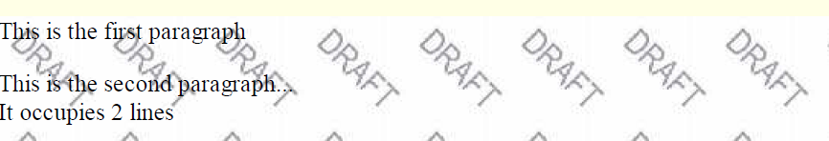
background-image
body {
background-image: url("images/draft.jpg");
}
CSS
background image/color fills the element's content area

Slide 11

background-repeat
body {
background-image: url("images/draft.jpg");
background-repeat: repeat-x;
}
CSS
can be repeat (default), repeat-x, repeat-y, or no-repeat

Slide 12
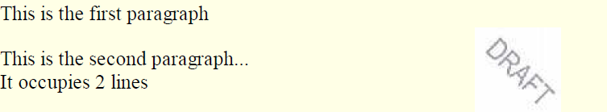
background-position
body {
background-image: url("images/draft.jpg");
background-repeat: no-repeat;
background-position: 370px 20px;
} CSS
value consists of two tokens, each of which can be top, left, right, bottom, center, a percentage, or a length value in px, pt, etc.
value can be negative to shift left/up by a given amount

Slide 13
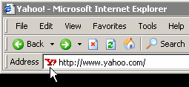
Aside: Favorites icon ("favicon")
<link href="filename" type="MIME type" rel="shortcut icon" /> HTML
<link href="yahoo.gif" type="image/gif" rel="shortcut icon" /> HTML
The link tag, placed in the HTML page's head section, can specify an icon
this icon will be placed in the browser title bar and bookmark/favorite

